Slide 1
Melvin the Marvellous Martian from Mars
Kevin Scroggins
Stephany Lay
Julie Powers

Slide 2
Overview
Introduction
Game Layout
Special Features
Features Not Implemented
Difficulties
Time Estimates
Game Design Layout
Demo

Slide 3
Introduction
Game Objective
  Player's goal is to explore Earth and repair their spaceship.
Game Flow
  Various parts of your ship are scattered across the world. The player has to find them while utilizing items they collect.

Slide 4
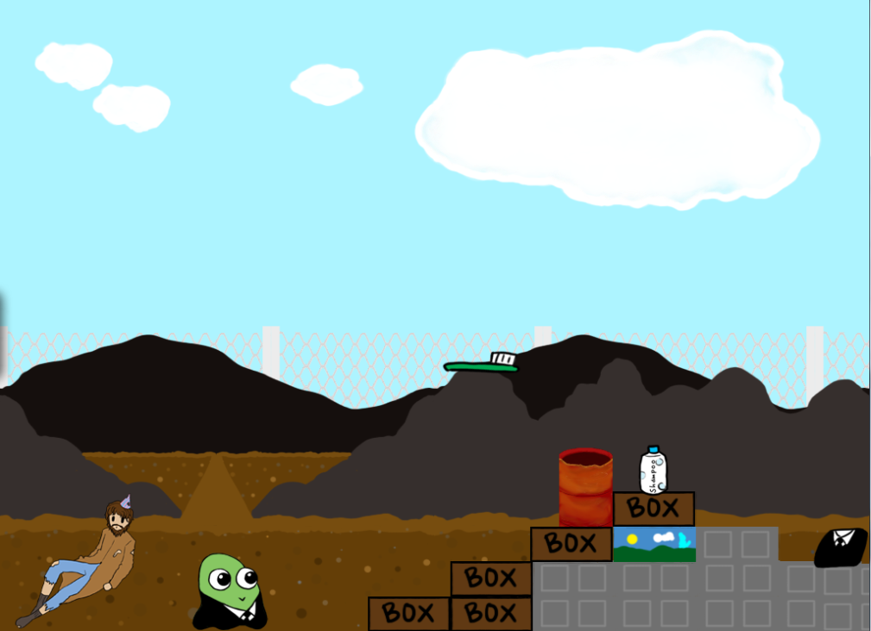
Game Layout

Slide 5
Special Features
Item Collection
Disguises
“Health bar”
Minimalistic HUD
Multiple levels

Slide 6
Technical Features
Level Editor
Sprite Sheet Parser Abstraction
Sprite and Text Abstraction
Menu
Configuration File and Parser
Window and Game Engine

Slide 7
Special Features not Implemented
Multiple Endings
Randomized items and levels
Central base
NPC and item interactions
Quest system
Side-scrolling
AI

Slide 8
Difficulties
Time Constraints
Coordinating Meetings
Technical Bugs
Collision Detection
Level Designer

Slide 9
Time Estimates
Task | Estimated Time | Actual Time | Reasons
Overall Effort | 205 hours | 492 hours | Our game is very content heavy.
Design of Game | 10 hours | 25 hours | Level design and puzzles took more time to plan than expected.
Design of Code | 5 hours | 5 – 7 hours | Good estimate
Implementation | 140 hours | 460 hours | 110 hours were spent on drawings. Testing, and special features where completed during the implementation process.
Integration and Testing | 20 hours
Incorporation of Special Features | 30 hours

Slide 10
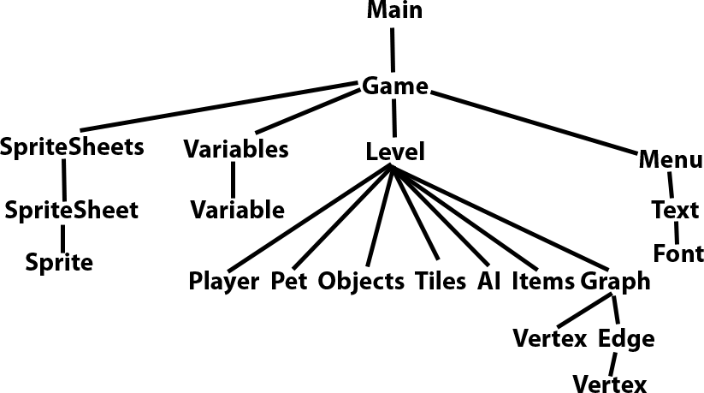
Game Design Layout

Slide 11
Demo

